Slide 1
Arduino Class
BE1200

Slide 2

Download Arduino IDE:
https://www.arduino.cc/en/software/

Slide 3
Hardware Basics:

Slide 4
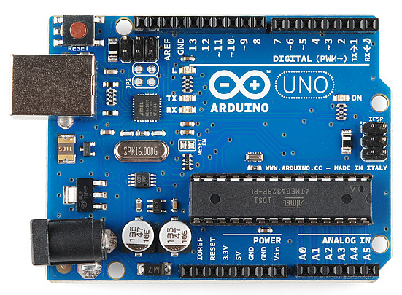
What is an Arduino?
Programable microcontroller that can take in inputs and produce outputs
Ex: push a button and light an LED
Microcontroller commonly used in home projects and prototyping
Able to remember code

Slide 5
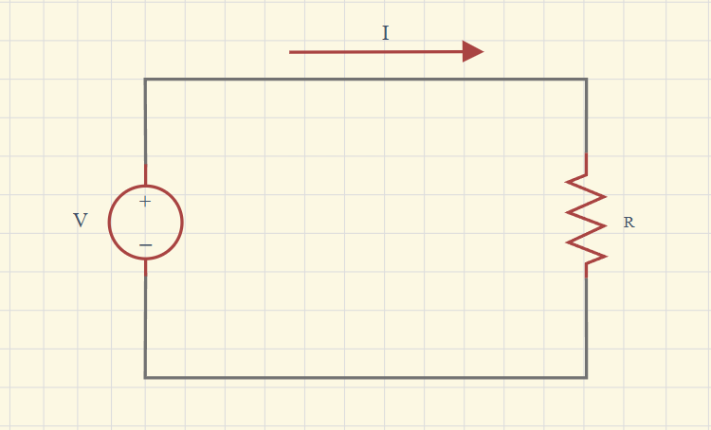
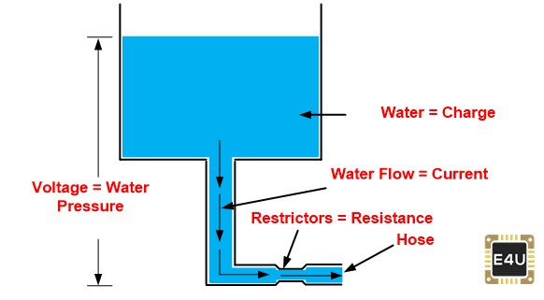
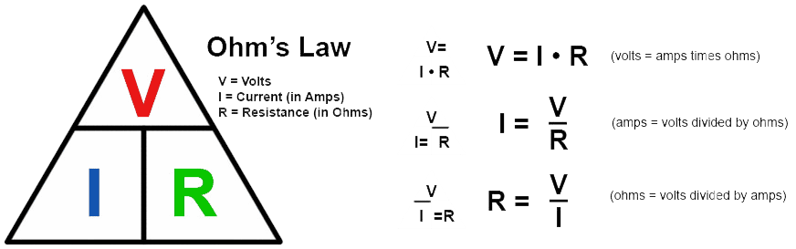
Overview of Circuits:
Circuit = Path for electric current to flow
Circuits need to be closed loop for current to flow
Ohms Law: Voltage = Current * Resistance
Voltage = Potential energy per unit charge
Current = Flow of electrons
Resistance = Measure of how much material is restricting current flow

Slide 6
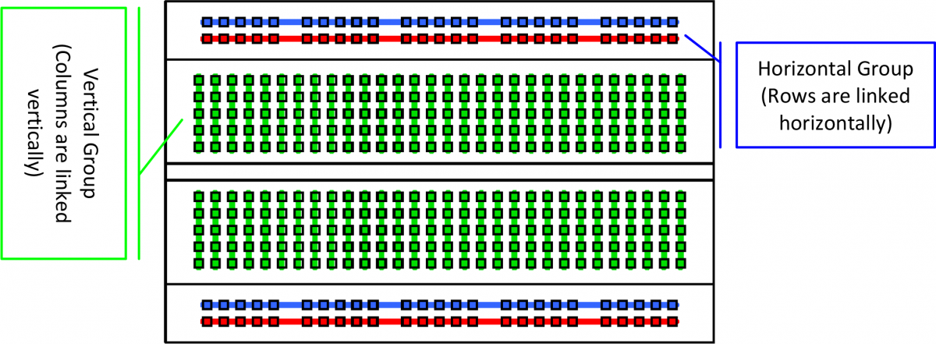
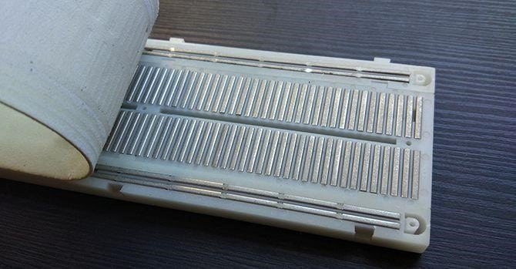
What is a Breadboard?
Solderless prototyping board to create circuits

Slide 7
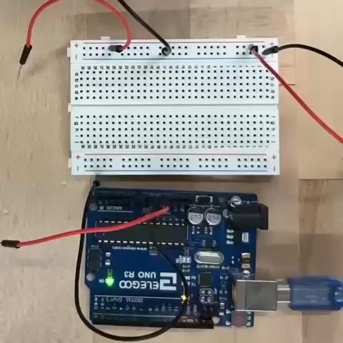
Powering the Breadboard:

Slide 8
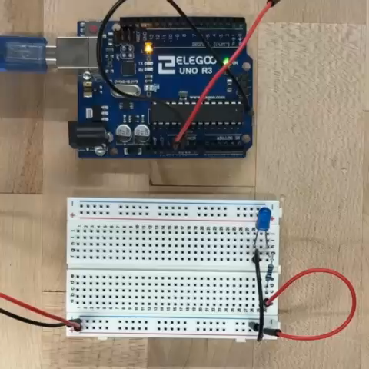
Fix: Lighting an LED:

Slide 9
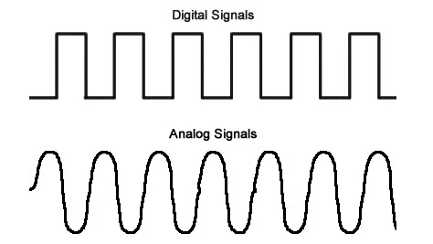
Digital vs Analog Pins:
Digital is 0s and 1s
1s and 0s, True or False, Off or On
Arduino has 14 digital pins
Ex: Light Switch
Analog is 0-255
Able to read/write variables from 0-255
Arduino has 6 analog pins
Ex: Thermostat, Joystick

Slide 10
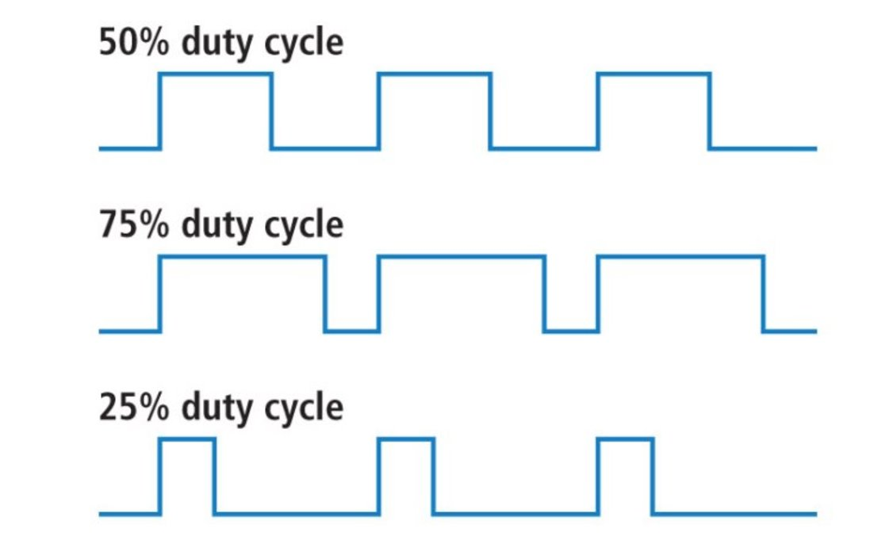
PWM (Pulse Width Modulation):
What is it?​
A way to convert a digital signal to analog​
Used to control speed of DC Motors​
Duty Cycle:​
Percentage of time a device is active

Slide 11
Types of Motors:

Slide 12
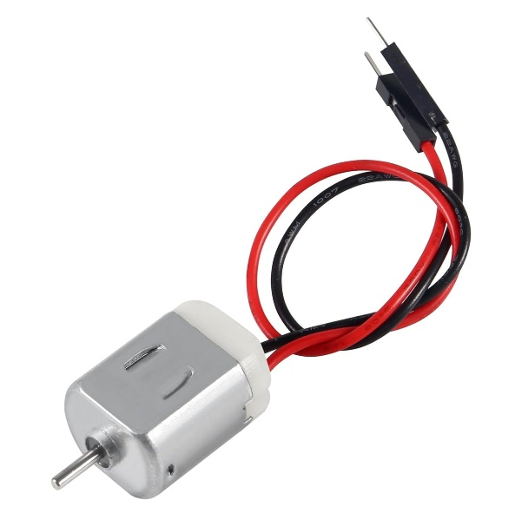
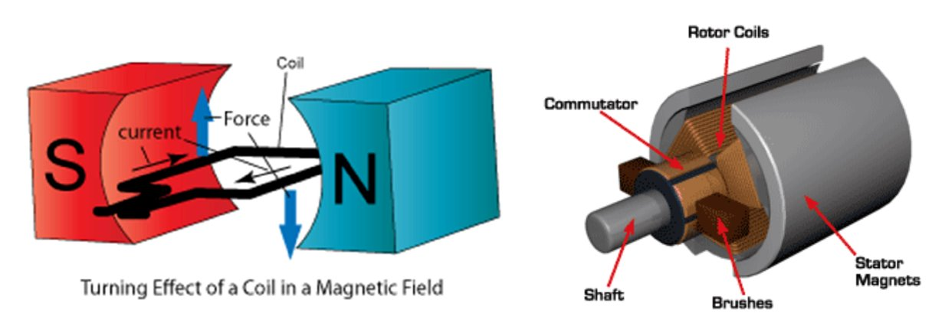
DC Motor:
Stands for Direct Current Motor​
Current gets passed through and creates a magnetic field which causes the motor to spin
Needs a motor driver

Slide 13
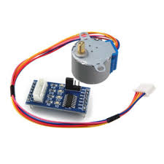
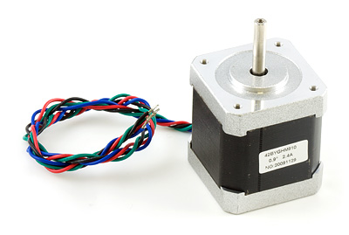
Stepper Motor:
Rotates in steps rather than continuously
Good for precise movements
Needs a motor driver

Slide 14
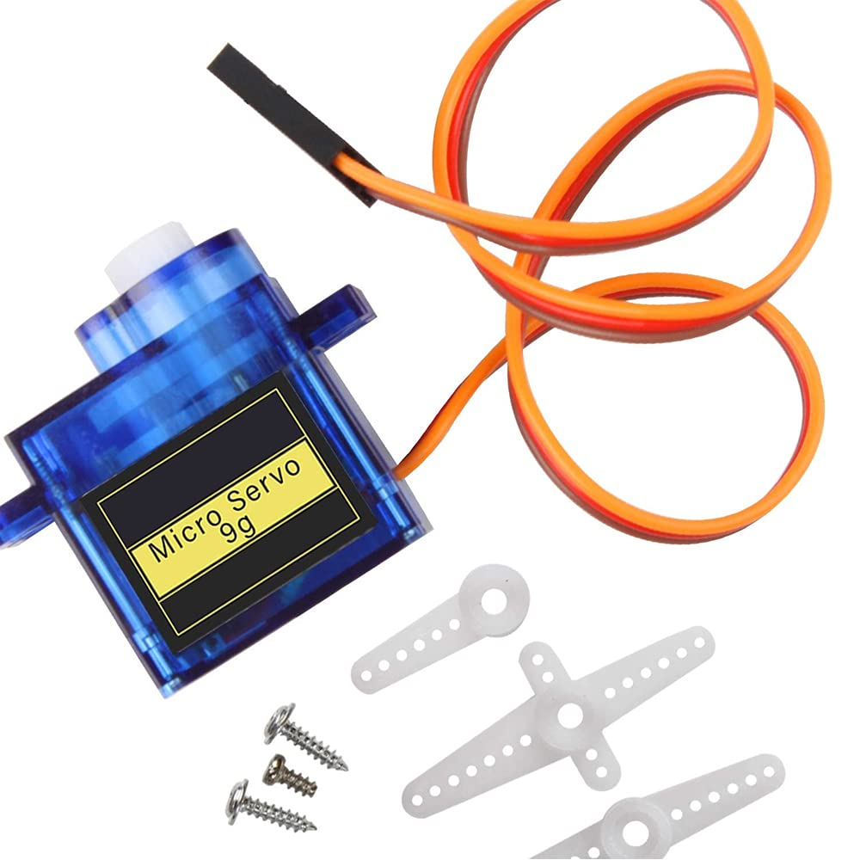
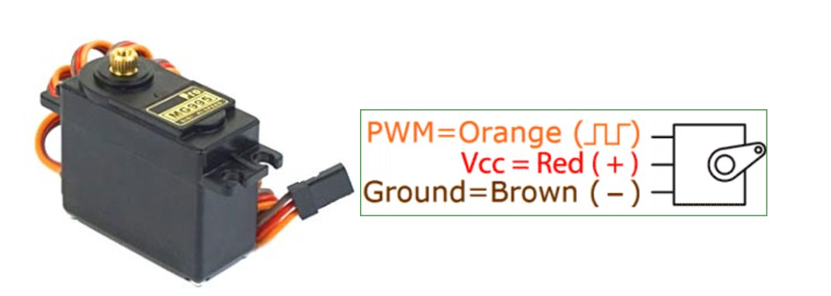
Servo Motor:
Motor designed for precise control of position​
Has 3 pins (ground, voltage, and a control pin)​
Moves 180 or 360 degrees
No motor driver required

Slide 15
Other Hardware:

Slide 16
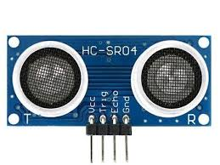
Ultrasonic Sensor:
Measures distance from an object with sound waves
The sensor sends out a signal then tracks how much time it took for the signal to come back

Slide 17
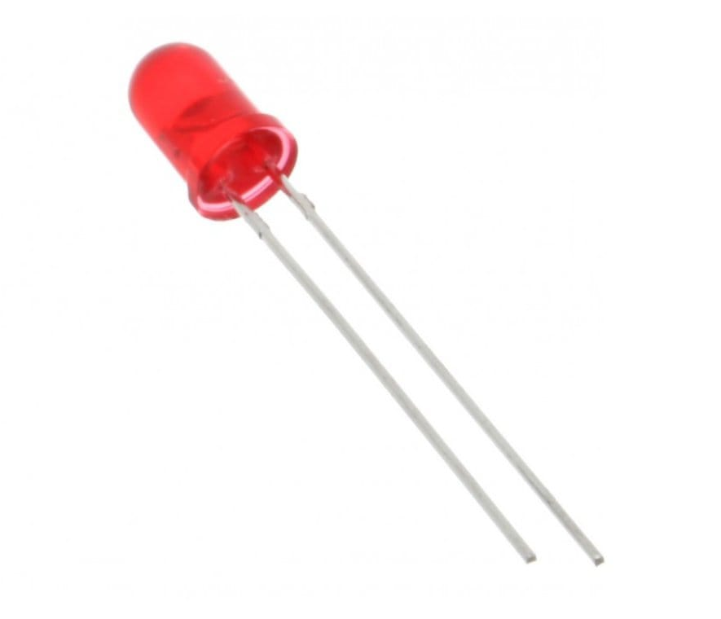
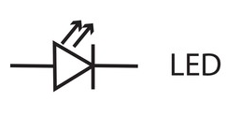
LED:
Short for “Light emitting diode”
Current flows in one direction
Long lead attaches to power
Short lead to ground
Long lead = Anode
Short Lead = Cathode

Slide 18
Coding Basics:

Slide 19
Useful Definitions:
Int = Integer (whole number)
ex: 2
Void = No return
Function = Block of code used to perform a specific task
Variable = Named placeholder for data
Boolean = Data type that can only be True or False
Logic Operation = Comparison between Booleans
ex: AND, OR, NOR

Slide 20
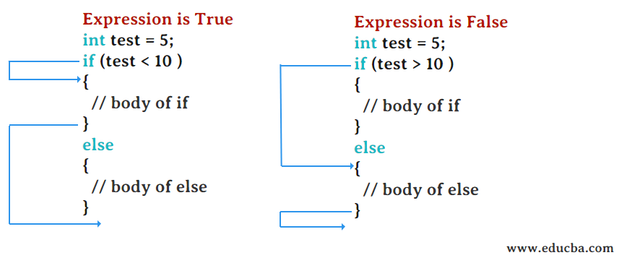
If/Else Statement:
Says "If I receive this input do this, anything else do this"
In Arduino (C++) statements will be contained in {}
int i=0;
if (i>1)
{do this}
else
{do this}

Slide 21
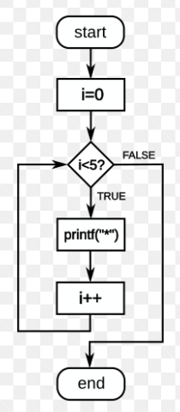
For Loop:
Says "For each time in this interval do this“
int add =0;
for (int i=0; i<5; i++)
{
add=add+1;
}
Serial.print(“Add =”)
Serial.print(add)
Result: "Add =5"

Slide 22
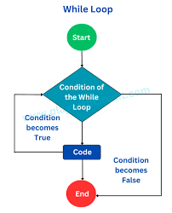
While Loop:
“While this is true do this”
int add =0;
int i=0;
while (i<5)
{add=add+1;
i=i+1}
Serial.print(“Add =”)
Serial.println(add)
Result: "Add =5"

Slide 23
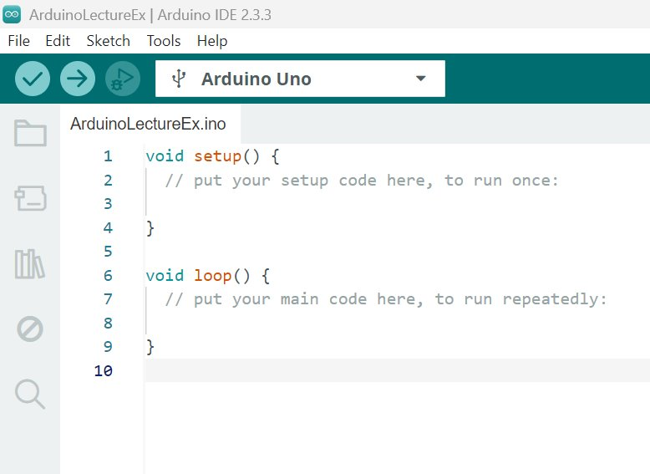
Arduino Initial Code:

Slide 24
Void Setup():
void setup():
Runs once at beginning of code
Where you initialize pins as inputs or outputs
Starts the Serial Monitor
Serial monitor is where you can see print statements

Slide 25
Void Loop():
void loop():
The main code that will run if there is a power source
Where you application will take place

Slide 26
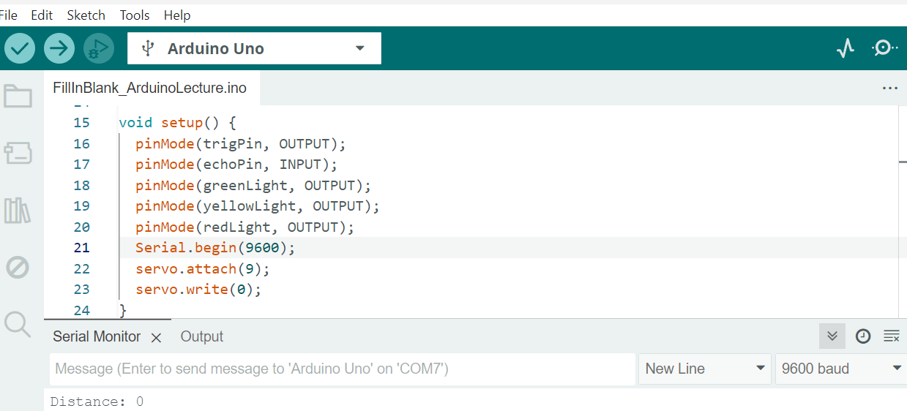
Serial Monitor:
Allows for 2-way communication between your computer and the Arduino
Able to take user inputs
Where print statements will appear
Initialize by putting Serial.begin(9600) in the setup function

Slide 27
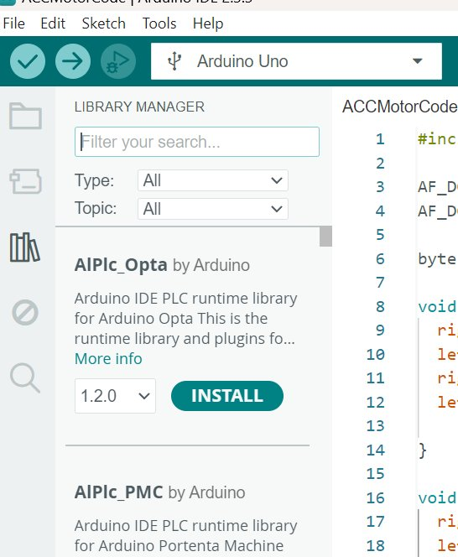
Download Servo Library:
Steps:​
Click on the library manager icon on the left side of the screen​
Search "Servo.h"​
Install the servo library

Slide 28

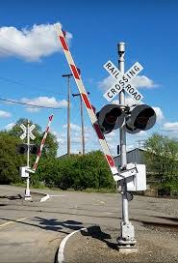
Project: Smart Train Crossing

Slide 29
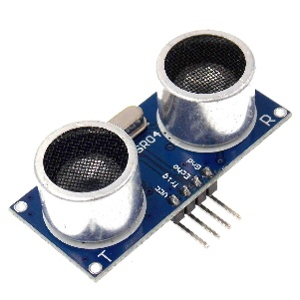
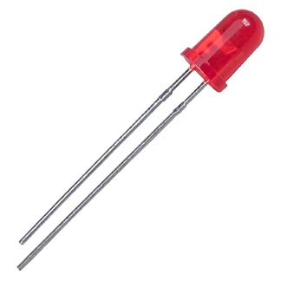
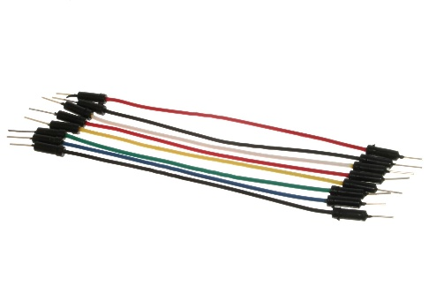
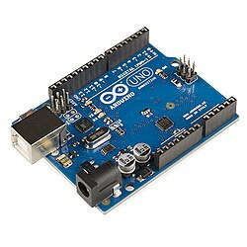
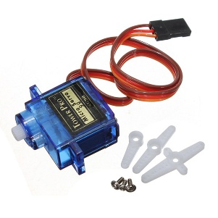
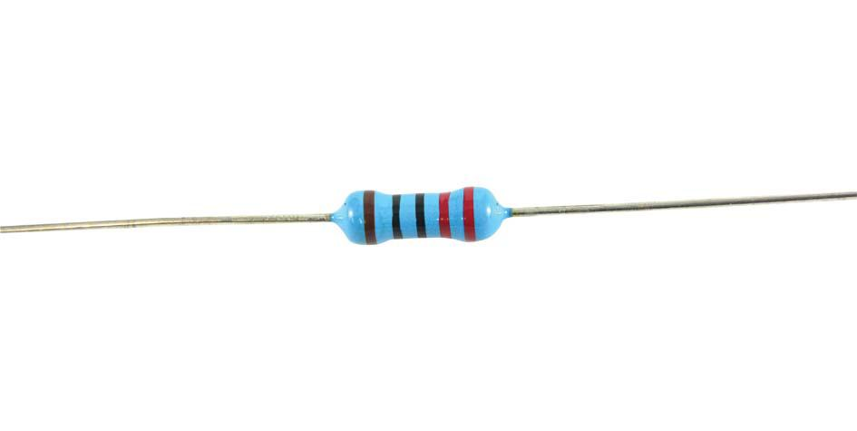
Materials Needed:
Arduino
Ultrasonic sensor
Jumper wires
1 bread board
3 220 Ω resistors
3 LEDs
1 Servo Motor

Slide 30
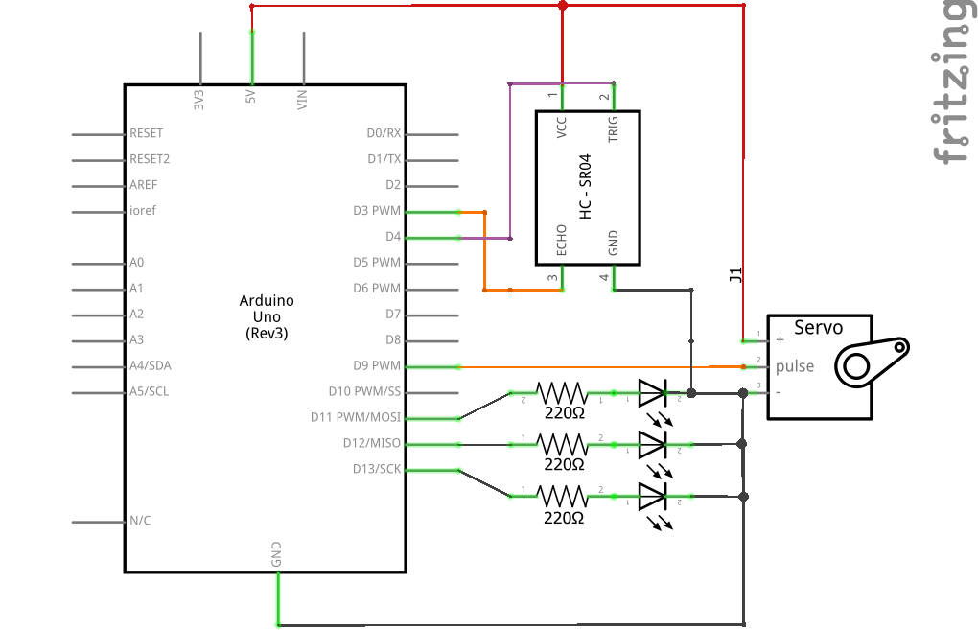
Schematic:
*Made in Fritzing

Slide 31
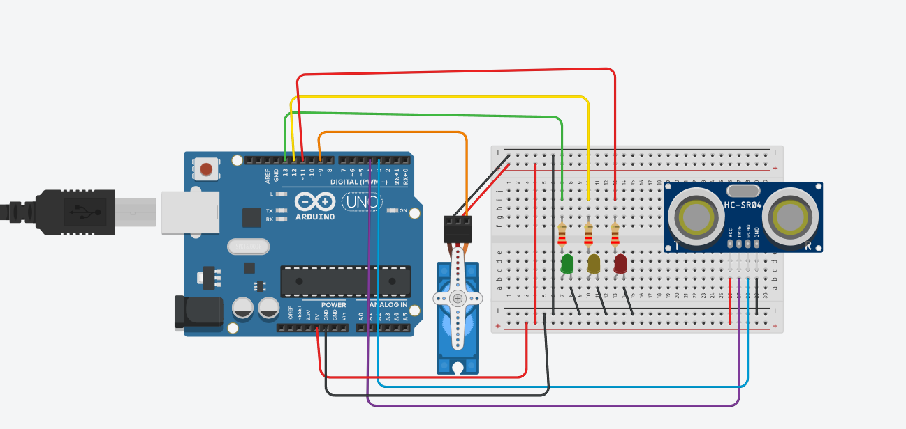
Circuit
*Made in TinkerCad

Slide 32
Things to Remember When Wiring:
Attach power to the breadboard
Attach ground to the breadboard
Voltage rating for components
For LEDs long lead to power, short to ground

Slide 33
Code:

Slide 34
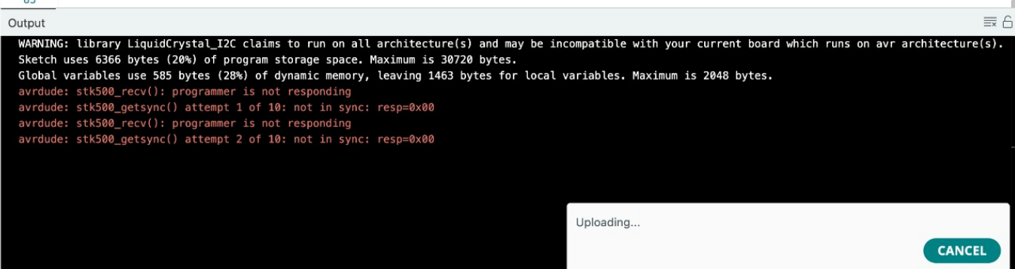
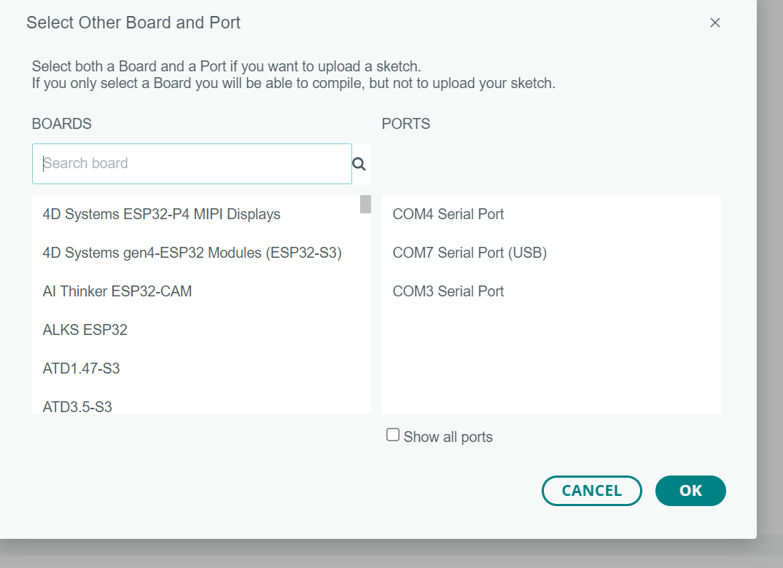
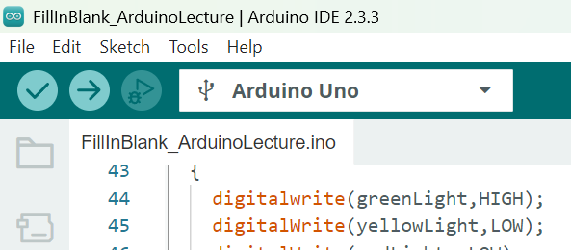
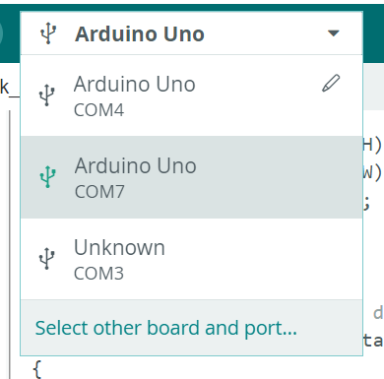
Errors for Mac Users:
*only for Mac users
To Fix:
Click the dropdown to see your currently connected port
Select “Select other board and port”
Check you are connecting to an Arduino Uno
Unplug your Arduino and plug it back in. Watch for what port appears when you plug back in and select that one.
1
2
3
4

Slide 35
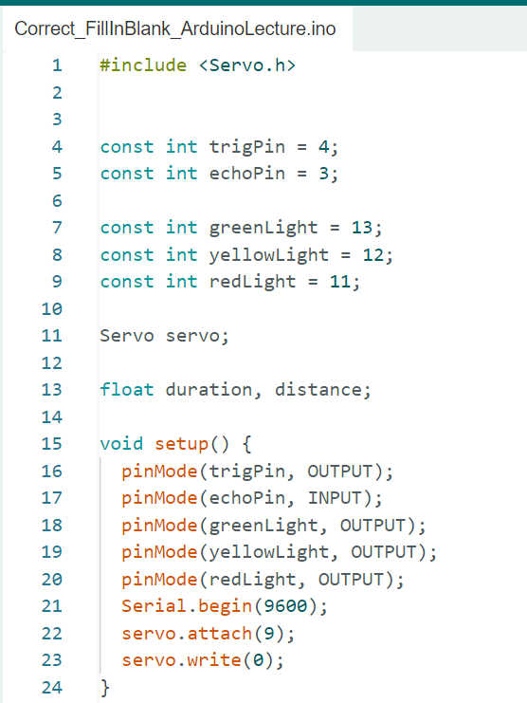
Initializations/Setup():
Initializations:
Declaring all pins as const int (integers that won't change)
Creating a Servo named “servo”
Setup()
Setting pins as inputs or outputs
Starting the Serial Monitor
Attaching the servo
Bringing the servo to the initial position

Slide 36
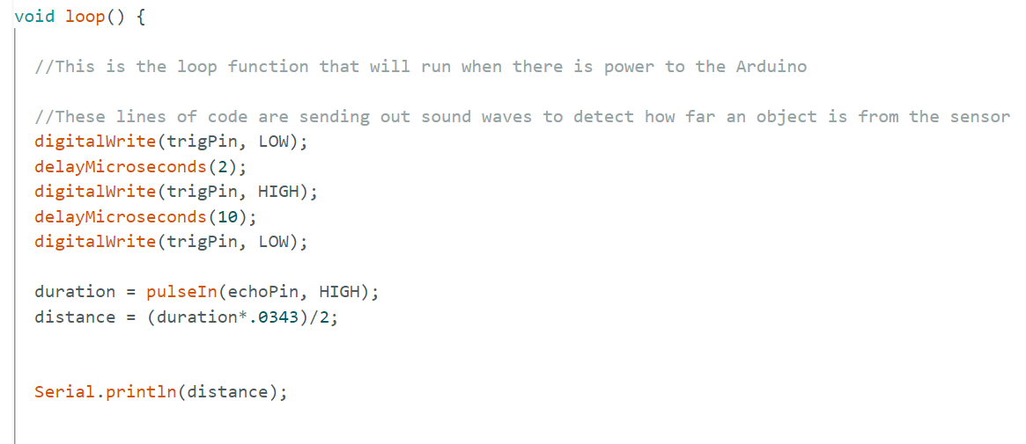
Measuring Distance in Loop():
Send a pulse out and wait for it to bounce back
Calculate the distance from the measured time
Print the distance in the serial monitor

Slide 37
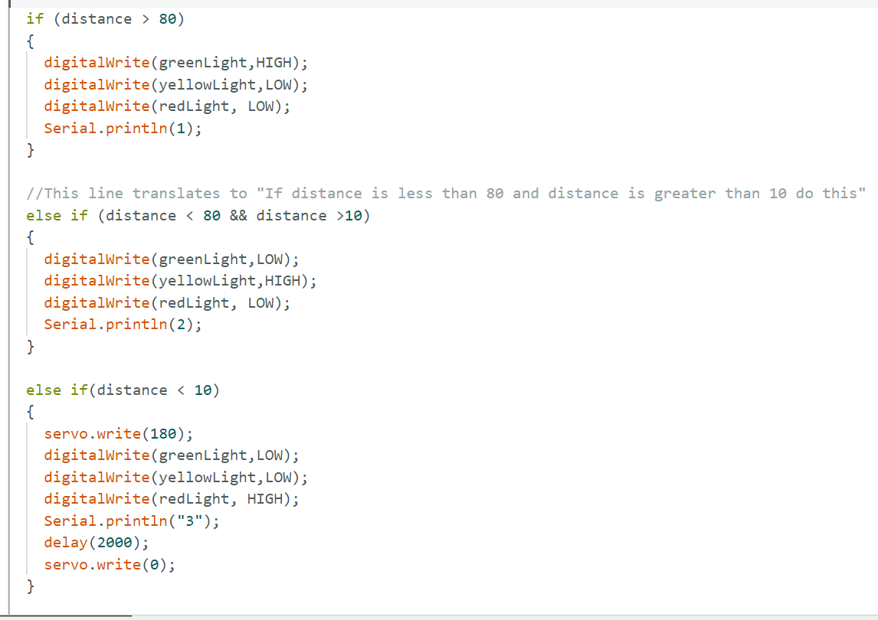
Turning on LEDs and Motor in Loop():
If/else statements to determine what LED lights up
Prints the State in the serial monitor
If the distance is close, servo will move, stop for 2 seconds, and move back to the initial position

Slide 38
Code Corrections:
Line 1: Delete the "//"
"//" in front of anything symbolizes it is being commented out. A comment makes it so what you type will not be ran by the compiler. This is how you can document code and write notes.
Line 32: Change digitalwrite()-> digitalWrite()
In coding, common practice is to capitalize the first letter of the second word since you are unable to use spaces. You may also see "_" in place of a space
Line 67: delay(2) -> delay(2000)
The delay function takes inputs in milliseconds. If the delay is too slow the motor will not get a chance to move
Line 72: Delete the "//"
This is to slow down the rate the data is being received. This change can be seen in the Serial Monitor

